Slide 1
INTRODUCTION
Notes:
Suggested Time Required: 14 hours

Slide 2
Mission Statement
To provide Career Development Team (CDT) members with the foundational knowledge and skills required to execute an effective and robust Career Development Program (CDP).
Notes:
FACILITATOR GUIDE:
None.

Slide 3
Introduction
Facilitator Introductions
Counselors Introductions
Create list of Classroom “norms”
Notes:
FACILITATOR GUIDE:
Use this time to conduct class norms and introductions.
Create your own Introduction ahead of time on the slide.
Examples:
Name/Rate:
How long have you been in the Navy:
Commands stationed at:
Experience:
Fun fact about self:
*facilitators introduction should match the counselors introductions.
Create your own Classroom Norms.
Examples:
Be on time/ Respect everyone's time and input
Clean up your space
Trash to be removed every day
Stay on task during instruction

Slide 4
CAREER DEVELOPMENT PROGRAM
Notes:
Suggested Time Required: 14 hours

Slide 5
Enabling Objectives
STATE the purpose of a Career Development Program (CDP)
STATE the purpose of OPNAVINST 1040.11F
STATE the purpose of NAVPERS 15878N
DISCUSS key elements of the Career Information Program Review (CIPR) checklist
DISCUSS Department and Divisional Counselor CIPR responsibilities
Notes:
FACILITATOR GUIDE:
Review objectives
Focus of this training topic should be geared towards building level of knowledge in our newly identified counselors “to be” with emphasis on their role in management of CDP.
Printouts of CIPR and an example of an POA&M can be utilized as handouts for this lesson.

Slide 6
References
OPNAVINST 1040.11F - Navy Enlisted Retention and Career Development Program
NAVPERS 15878N - Bureau of Naval Personnel Career Counselor Handbook
NAVPERS 1040/2 (Rev. 09-2025) - Career Information Program Review
NAVEDTRA 43699D - Command Career Counselor Personnel Qualification Standard (PQS)
Notes:
FACILITATOR GUIDE:
Review references

Slide 7
Career Development Program (CDP)
Purpose of the CDP:
Improve the ability of Sailors to achieve their professional goals and positively impact their desire to remain on Active Duty or transition to the Navy Reserve
Active LEADERSHIP involvement, from the top down is the key element for a successful CDP
The PILLAR of a successful CDP is a knowledgeable and effective Career Development Team (CDT)
Notes:
FACILITATOR GUIDE:
Key efficiency and effectiveness of CDT members in management of CDP are measured with CIPR checklist and later expounded upon in this lesson.

Slide 8
Career Development Program OPNAVINST 1040.11F
This instruction is designed to function as guidance for all Navy commands
To provide guidance for the management and operation of the Navy Enlisted Retention and Career Development Program (CDP)
Lists the responsibilities from the Deputy Chief of Naval Operations to the Departmental Leadership
Notes:
FACILITATOR GUIDE:
Primary Instruction That Governs What We Do!
Provides guidance and delineates the duties and responsibilities of each stakeholders that are charged with management of the CDP.
All CDT members MUST ADHERE to this policy!

Slide 9
Career Development Program NAVPERS 15878N
Provides commands and career counselors the necessary tools to develop, implement, and direct an effective career development program
Serves as the "how-to" guide in the implementation and management of the Career Development Program
Lists web-based applications required in execution of the CDP and how to gain access
Contains screen shot tutorials on each web-based application for functionality and familiarization
Notes:
FACILITATOR GUIDE:
A great resource to have in your toolbox. It goes into details that the OPNAVINST 1040 series may not cover as it relates to supporting functions of a career counselors i.e. Transition requirements and familiarization with DMDC website, most common items of interest from Sailors along with associated forms etc. When sufficient hands-on OJT is not attainable, this resource is available to aid counselors in their familiarization and execution of duties. Keep in mind that all personnel issues and procedures are governed by an MILPERSMAN articles i.e. reenlistment, CWAY, separations etc. and will be expounded upon later in this training.

Slide 10
Career Development Program DEPARTMENT/DIVISIONAL CAREER COUNSELOR RESPONSIBILITIES
Department career counselors will assist in facilitating CDTC and FTSW.
Conduct CDBs on assigned personnel per OPNAVINST 1040.11F.
Document CDB minutes using the ICDP in CIMS.
Provide a monthly report to departmental leadership.

Slide 11
Career Development Program Career Information Program Review (CIPR)
NAVPERS 1040/2 (Rev. 09-2025)
Primary resource utilized to assess the effectiveness of a command’s CDP.
Resource for commands to objectively self-assess their organizational strengths and other areas that require further attention.
The command must be evaluated annually.
Department reviews are conducted annually by the CCC and it is strongly recommended prior to any turnover by Departmental CCs (DCC).
Referenced when being considered for Retention Excellence Award (REA).
Notes:
FACILITATOR GUIDE:
In addition to above, self-assessment can be conducted locally during turnover of duties between DEPT/DIV CC’s and retain with CCC. Always refer to latest NAVADMIN and message from TYCOM as it relates to REA and CCOY requirements.

Slide 12
Career Development Program Career Information Program Review (CIPR)
Provides a means to assess the effectiveness of programs and support systems that directly impact the command climate
Career Development Program Management
Career Development Team (CDT)
CDT Training
Career Development Boards (CDB)
Professional Apprentice Career Tracks (PACT)
Career Waypoints (C-WAY)
Transition Assistance Program (TAP)
Notes:
FACILITATOR GUIDE:
Communicate with your Triad to determine an inspection date that works best with the command’s schedule
Coordinate availability with your ISIC/TYCOM to confirm an inspection date
Schedule an in-brief and debrief for your triad
Complete a self-assessment and forward a copy to your inspector at least 14 days prior to scheduled CIPR date

Slide 13
Career Development Program Career Information Program Review (CIPR)
NAVPERS 1040/2: Career Information Program Review (Rev. 11-2025)
Department/Divisional CC:
SAMPLE
Notes:
FACILITATOR GUIDE:
It is the responsibility of the CCC to conduct this assessment of their DEPT CC prior to ISIC/TYCOM overall assessment of CDP. Having access to all IP services to perform duties will be granted after CDTC is complete and designated in writing by the CO. A POA&M must be generated to address areas of concern.

Slide 14
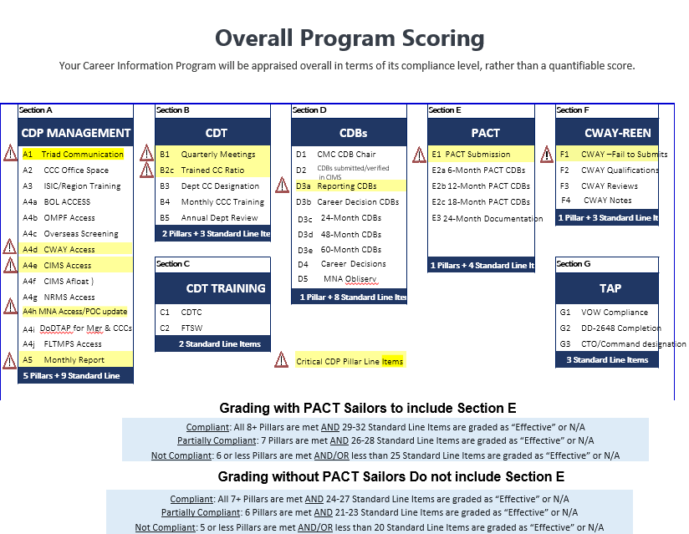
Career Development Program Career Information Program Review (CIPR)
Notes:
FACILITATOR GUIDE:
Screen shot of standard line items with critical pillars identified. Emphasis and due diligence is required in the management of critical pillars.

Slide 15
Career Development Program Career Information Program Review (CIPR)
Plan of Action and Milestone (POA&M)
Report must be generated for line items marked as “No”
POA&M will state specific actions to be taken; program manager who is responsible for completing the action; the start, milestones, and completion dates; and expected results
Will be completed and forwarded to CCC within 30 calendar days of CIPR
The DCC and CCC alone should not be the action person
Ensure each stakeholder (designated person) takes ownership of their portion
The CDT must work together in keeping CDP online and effective
Notes:
FACILITATOR GUIDE:
Having full support from TRIAD and remaining CDT will result in a successful review. Preparation ahead of time is key. Do not hesitate in requesting an ISIC CIPR site visit at least 90 days prior to official review and be sure to conduct an honest self-assessment prior to ISIC visit.

Slide 16
Career Development Program POA&M Example
ACTION | ACTION PERSON | START DATE | MILESTONE DATE | EXPECTED RESULT
Action item will always begin with a verb and needs to be specific | This is the person responsible for completing the action item | Be specific on when you can realistically start this action item | Be specific and realistic. Completing 100 CDBs will take longer than completing 20 CDBs | This is the result/reason why we need to complete the action item
Conduct Quarterly Career Development Team (CDT) meetings | (Insert Counselor Name, and others required to complete action) | XX October 20XX | XX October 20XX / Quarterly | Ensures leadership is abreast of all current career development programs and policies
Generate monthly Career Development Program (CDP) report for Nov, Dec, and Feb | (Insert Counselor Name, and others required to complete action) | XX October 20XX | XX January 20XX | Ensures the chain of command stays up to date on the status of the Career Development Program
Conduct Seven missing Reporting Career Development Boards (CDBs) | (Insert Counselor Name, and others required to complete action) | XX October 20XX | XX January 20XX | Ensures all newly reported Sailors are provided the guidance necessary to make informed career decisions based on current Navy policies, programs, and procedures
Train an additional three CDT members to meet the 30:1 ratio | (Insert Counselor Name, and others required to complete action) | XX October 20XX | XX January 20XX | Be in compliance of the 30:1 ratio
Conduct monthly training with department/division CC | (Insert Counselor Name, and others required to complete action) | XX October 20XX | XX October 20XX / Monthly | Ensures the CDT stays up to date on all career development program requirements
Designate two career counselors | (Insert Counselor Name, and others required to complete action) | XX October 20XX | XX January 20XX | To be in compliance with OPNAV 1040.11E
Notes:
FACILITATOR GUIDE:
None.

Slide 17
Knowledge Check
You prepare a POAM after departmental and command CIPRs?
True or False
OPNAVINST 1040.11F is designed to function as guidance for all Navy commands.
True or False
What Provides commands and career counselors the necessary tools to develop, implement, and direct an effective career development program?
Notes:
FACILITATOR GUIDE:
This is an opportunity for you to discuss “share best practices” that are unique to your cognizant relating to the effective management of CDP.

Slide 18
Summary and Review
In this lesson we discussed
OPNAV 1040.11F
CCC Handbook and how it is a vital resource for your toolbox
Utilization of the CIPR checklist (NAVPERS 1040/2 Rev. 9-2025) to conduct a self-assessment in determining the health of the CDP
Preparing and executing a POA&M as required
Keeping your CDT informed and updated on CDP matters
To never hesitate to communicate with your CCC and/or ISIC
Notes:
FACILITATOR GUIDE:
This is an opportunity for you to discuss “share best practices” that are unique to your cognizant relating to the effective management of CDP.

Slide 19
Questions?

